Slide 1
shadows
Taught by Yossef Ayman Zedan

Slide 2
Examples
While shadows on components are disabled by default in Bootstrap and can be enabled via $enable-shadows, you can also quickly add or remove a shadow with our box-shadow utility classes. Includes support for .shadow-none and three default sizes (which have associated variables to match).
<div class="shadow-none p-3 mb-5 bg-light rounded">No shadow</div> <div class="shadow-sm p-3 mb-5 bg-body rounded">Small shadow</div> <div class="shadow p-3 mb-5 bg-body rounded">Regular shadow</div> <div class="shadow-lg p-3 mb-5 bg-body rounded">Larger shadow</div>

Slide 3
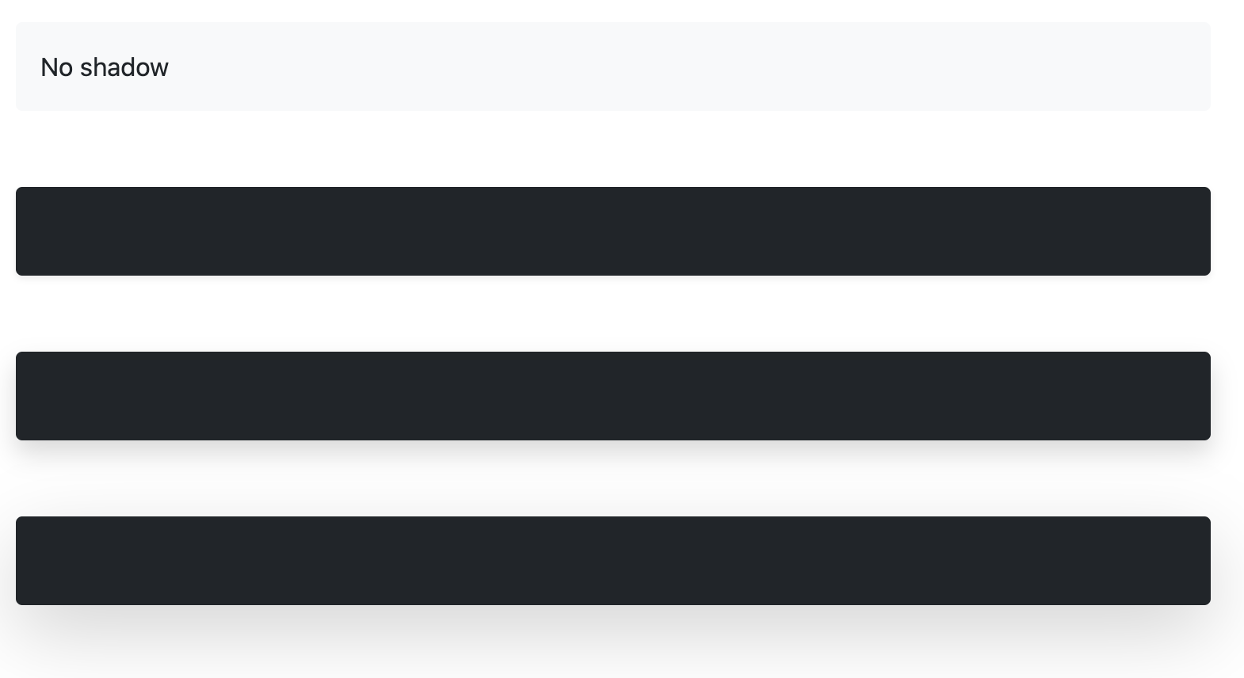
Examples

